Slide 1


IMUN CAMPUS AMBASSADOR INTERNSHIP

Slide 2


Slide 3

INTERNATIONAL MODEL UNITED NATIONS
International MUN brings youth together from around the world to learn and share ideas from a diverse set of experiences and backgrounds in its offline and online Model United Nations confereneces.
MUN is a simulation of actual United Nations conference, where students are tasked with solving a global issue thrrough research, drafting, lobbying and debate to pass a suitable RESOLUTION.

Slide 4
TAKEAWAY FROM IMUN
01
02
03
04
WORLDLY KNOWLEDGE
CONFIDENCE BUILDING
ANALYTICAL SKILS
PROBLEM SOLVING SKILLS

Slide 5
STILL MORE......
DIPLOMACY
5
PUBLIC SPEAKING
6
LEADERSHIP SKILLS
7
8
WRITING

Slide 6
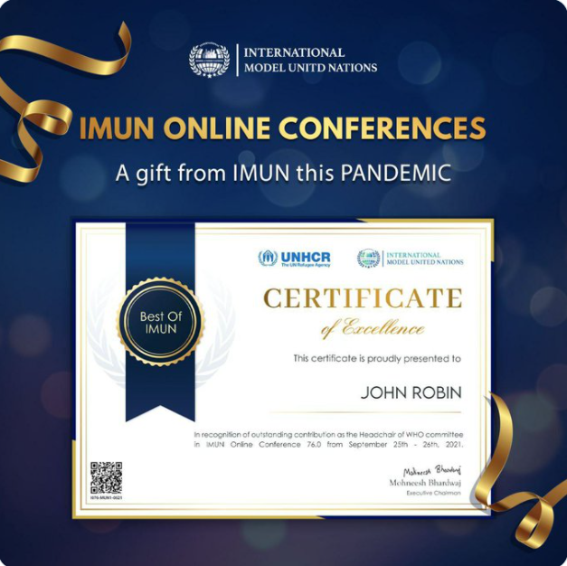
MAIN REASON

Slide 7
TASKS!!!
5 WEEK INTERNSHIP
FOR FREE
PARTICIPATE IN IMUN CONFERENCES WITH 899/-
TASK IS TO BE A BRAND AMBASSADOR OF IMUN

Slide 8
https://docs.google.com/forms/d/e/1FAIpQLScgn1-njVrA3qsyKXuxOVJDxaV44wyo6HZfUQcqkE1AIF8IQQ/viewform
INTERNSHIP
https://www.internationalmun.org/get_link.php
REFERAL
MAIN WEBSITE
https://www.internationalmun.org/

Slide 9
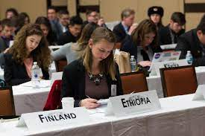
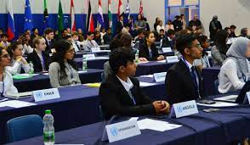

Slide 10
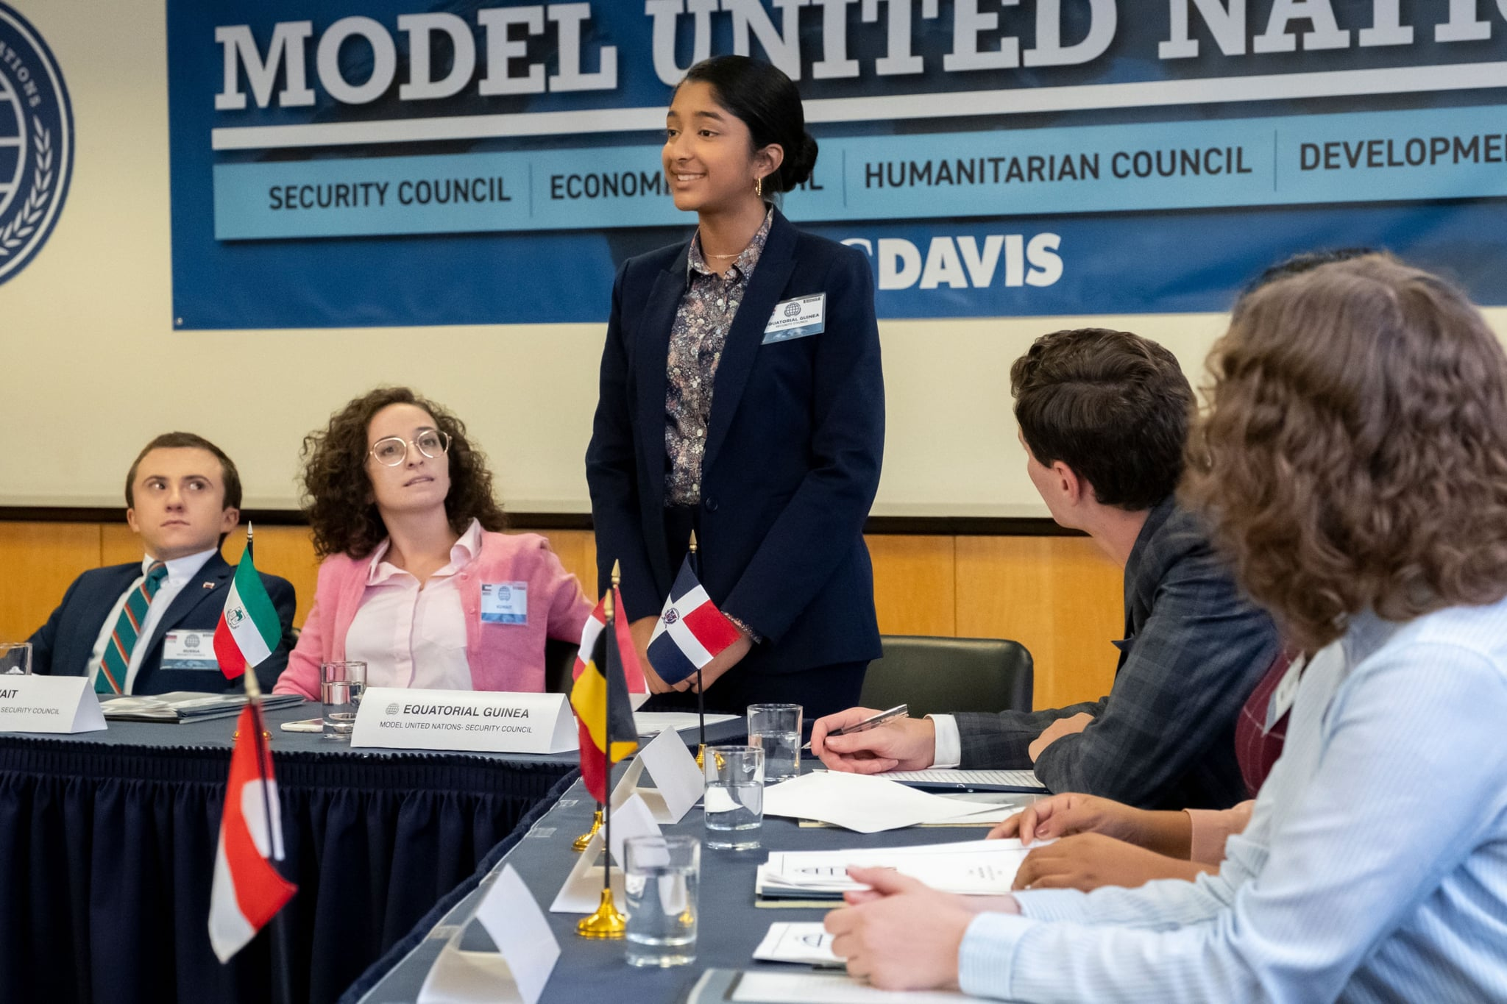

Slide 11
Thank you for listening

